Slide 1
A Simple Evolutionary Algorithm The Random Mutation Hill-Climber
Simon Lucas

Slide 2
My Favourite Evolutionary Algorithm Random Mutation Hill-Climber (RHMC)
Ultra-simple
Performance very good across a range of problems
Prone to get stuck in local optima
So run with random restarts!!!
AKA: (1+1) ES
Especially when optimising a vector of real numbers

Slide 3
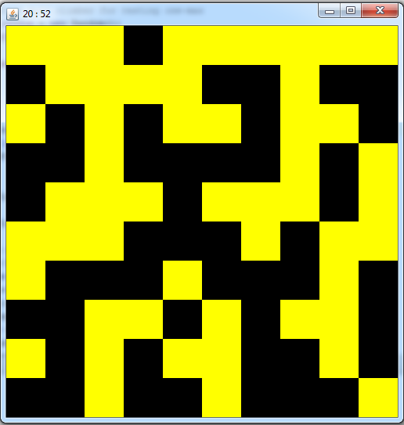
Visualisation: Demo Code for OneMax Problem solved when all grid is yellow

Slide 4
The Algorithm
Make a random solution – call it bestYet
Repeat until termination
mutatedCopy := copyAndMutate(bestYet)
If (mutatedCopy is better or equal to bestYet)
bestYet := mutatedCopy
Terminate if bestYet is good enough
OR we’ve run out of time
Question: where is the fitness evaluation done?

Slide 5
RHMC Algorithm (for vector of real, co-evolution)
public double[] run(int nEvals) { for (int i=0; i<nEvals; i++) { // randomly mutate the best yet double[] mut = randMut(bestYet, stepFac); double diff = eval.pointsDiff(bestYet, mut); if (diff >= 0) { bestYet = mut; } } return bestYet; }

Slide 6
RHMC Algorithm And with adaptive step size
public double[] run(int nEvals) { for (int i=0; i<nEvals; i++) { // randomly mutate the best yet double[] mut = randMut(bestYet, stepFac); double diff = eval.pointsDiff(bestYet, mut); // if it's better then adopt the mutation as the new best if (diff >= 0) { bestYet = mut; // try making it bigger - make even faster progress stepFac *= stepAdjust; } else { // try making the step size smaller stepFac /= stepAdjust; } System.out.println(i + "\t " + mag2(bestYet)); } return bestYet; }

Slide 7
Test RHMC on the one max problem
Aims to evolve a binary vector of all ones
Useful test problem
Easy: no local optima
Gives a rough idea of how long the algorithm may take to learn a given number of bits for a similarly easy problem
But many real-world problems are tougher and have local optima
And epistatis – where the meaning of a symbol in one part of the solution depends on one or more other parts
Asteroids example of epistasis:
For a particular level of challenge, the optimal number and speed of Asteroids will depend on the missile firing rate of the ship (a rapid fire gun will enable the player to handle more fast moving Asteroids)

Slide 8
RHMC Algorithm Specific one max example
public Integer run(int nEvals) { for (int i=1; i<=nEvals; i++) { // randomly mutate the best yet int[] mut = randMut(bestYet); // if it's better then adopt the mutation as the new best if (countOnes(mut) >= countOnes(bestYet)) { bestYet = mut; } // System.out.println(Arrays.toString(bestYet)); if (countOnes(bestYet) == bestYet.length) { // return how many evals it took to reach perfection return i; } } // failed to find a solution return null; }

Slide 9
Lab Exercise - RHMC
Work out how to predict the “expected hitting time” of the algorithm on one max
This means, starting from a random bit vector, how many fitness evaluations are expected in order to reach the optimum (all ones)
Experiment with the code:
See ga.OneMaxTest
Observe how the expected hitting time varies with N
Develop a sum of series expression for this
Implement it in the method:
predictNEvals(int n)
How does it scale (e.g. is it O(N) ?)

Slide 10
Expected Hitting Time Exercise Hint
Key hint:
If an event has a probability of (1/N)
Then the expected number of samples before the event occurs is N
Start by considering how long it takes to flip the final incorrect bit
Then develop an expression for the total time

Slide 11
Evolutionary Game Design Exercise
In a later lab session:
adapt the Random Mutation Hill Climber code to optimise some aspect of a game
Approach:
Implement a GameParameter class
Have this implement an Evolvable interface
Then adapt the RHMC to evolve

